Slide 1

Civil Registration
Operational Functions and Activities: The Philippines Setting
ATTY. LOURDINES C. DELA CRUZ
Director III, Philippine Statistics Authority
14 November 2017
Hanoi, Vietnam
Republic of the Philippines
PHILIPPINE STATISTICS AUTHORITY

Slide 2
OUTLINE
Civil Registration
Operational Functions and Activities In The Philippines
1
Legal Framework of Civil Registration
2
Functional Components (births and deaths)
3
Republic Act No. 9048/ RA No. 10172

Slide 3
Legal Framework
Civil Registration
Operational Functions and Activities In The Philippines
Since 17th century -1898 (Spanish rule), there was no formal civil registration
Civil Registry Law (Act No. 3753)
Local Government Code of 1991
Republic Act No. 10625 or the Philippine Statistical Act of 2013 enacted on September 12, 2013

Slide 4

Live Birth
is the complete expulsion or extraction from its mother of a product of conception, irrespective of the duration of pregnancy, which, after such separation, breaths or shows any other evidence of life.
EXCEPTIONS:
If the fetus had an intra-uterine life of less than 7 months, it is not deemed born if it dies within 24 hours after its complete delivery from the maternal womb (Art. 41, R.A. 386)

Slide 5
Functional Components
BIRTH REGISTRATION
I . Birth in a health facility
Health Facility
Local Civil Registry Office
Philippine Statistics Authority

Slide 6
Functional Components
BIRTH REGISTRATION
II . Outside a health facility (home births)
Attendant at birth
Local Civil Registry Office
Philippine Statistics Authority

Slide 7

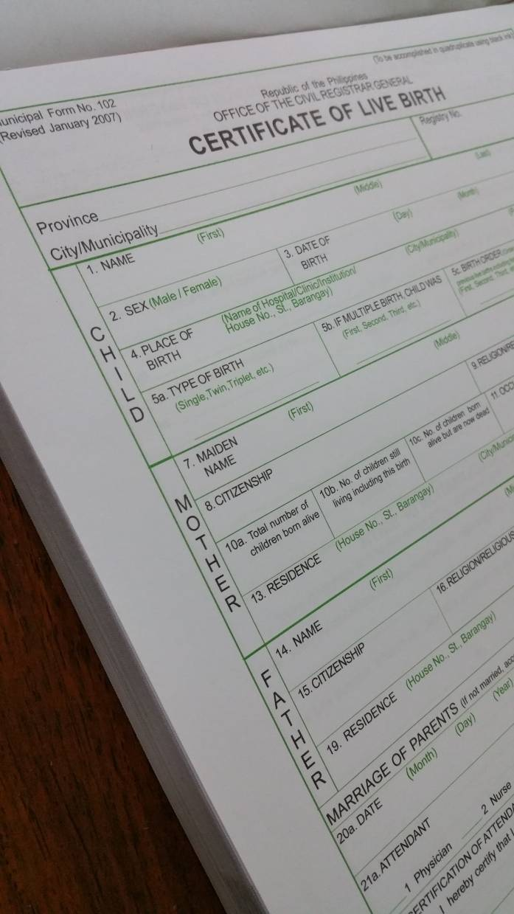
Birth Registration Procedures
Four copies of Certificate of Live Birth shall be accomplished and submitted to the LCRO for registration
  1st copy to the registrant;
  2nd copy to the OCRG;
  3rd copy shall be retained at the LCRO; and
  4th copy to the attendant at birth
How
to
Register

Slide 8

Birth Registration Procedures
Where to Register
General Rule:
The place of registration is the city/municipality where the event occurs

Slide 9
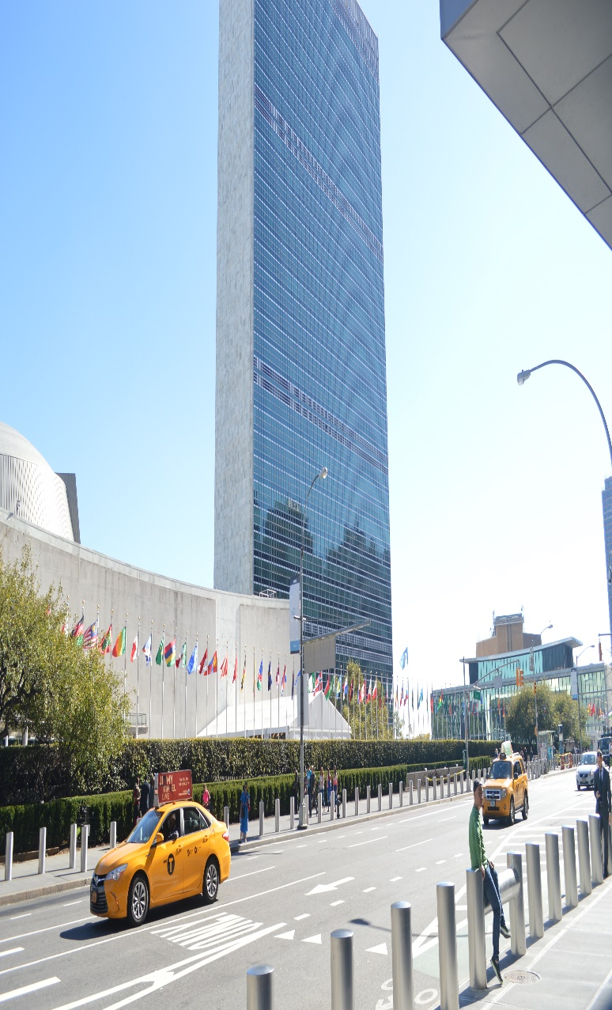
Reporting of vital event abroad
Birth Registration Procedures
All vital events occurring to Filipinos residing abroad (permanently or temporarily) shall be reported to the Philippine Foreign Service Post of the country of residence or where the vital event took place or where none is located thereat, in the Philippine Foreign Service Posts of the country nearest the place of residence of the party concerned or where the vital event occurred

Slide 10




Birth Registration Procedures
Person Responsible to Report
While on travel…
The bus driver or taxi driver, captain or pilot and the parents have the joint responsibility in causing the registration of birth to the LCRO.

Slide 11

Out-of-town Reporting
How does it takes place
  when COLB is presented to the LCR of a city or municipality which is not the place of birth,
  not for registration but to be forwarded to the LCR of the city or municipality where the birth occurred

Slide 12

Birth Registration Procedures
Reglementary Period
and Place of registration
The birth shall be registered within thirty (30) days from the time of birth in the LCRO of the city/municipality where the birth occurred
A report made beyond the reglementary period is considered late
30

Slide 13
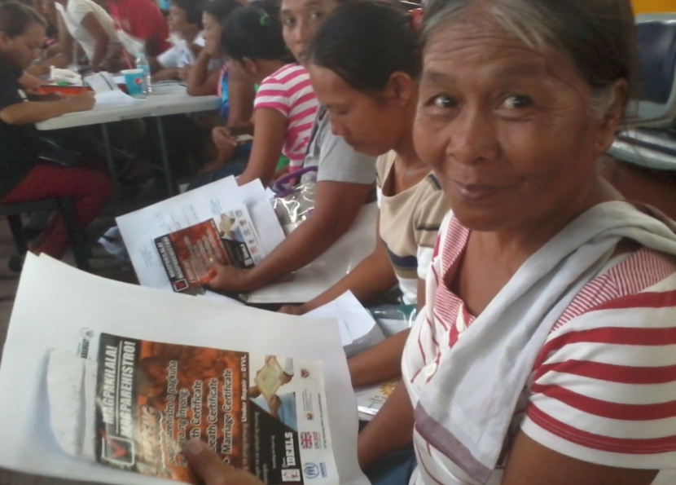
Delayed Registration of Birth
When a birth was reported beyond the reglementary period of 30 days.
Like ordinary registration made at the time of birth, it should be filed at the Local Civil Registry Office where the birth occurred.
Anita Salidaga, 60, of Tacloban's Suhi village lines up to process her late registration (Source: IDEALS Inc.)

Slide 14

Delayed Registration of Birth
Supporting Documents:
Any two of the following documents:
Baptismal certificate
school records
income tax returns
employment records
insurance policy
medical records
sworn statements of witnesses
SCHOOL RECORDS
BAPTISMAL CERTIFICATE
INCOME TAX RETURNS
EMPLOYMENT RECORDS
INSURANCE POLICY

Slide 15


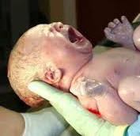

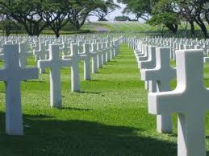
Death Registration Procedure

Slide 16

Death
Death refers to permanent disappearance of evidence of life
A fetus with intrauterine life of seven months or more and born alive at the time it was completely delivered from the maternal womb but died later shall be considered as death and shall be registered
Fetus with intra-uterine life of less than 7 months, dies within 24 hours after complete delivery (for statistical purposes only)

Slide 17
Death
Fetal death – is death prior to the complete expulsion or extraction from its mother of a product of conception, irrespective of the duration of pregnancy; the death is indicated by the fact that after such separation the fetus does not breathe nor show any other evidence of life, such beating of the heart, pulsation of the umbilical cord, or definite movement of voluntary muscles.

Slide 18
Death Registration Procedures
Attending physician will prepare the COD and certify cause of death. Administrator of the hospital will forward the death certificate to Local Health Officer (LHO)
Death certificate forwarded to LHO within 48 hours
LHO will examine certificate of deaths and will order registration at the Local Civil Registry Office (LCRO)
At the LCRO, Civil Registrar or authorized personnel checks the completeness and correctness of the entries on the COD, and enter the info in the Registry Book, Assign Registry Number, Issuance of Death Certificate. Transmittal to PSA
REGISTRATION
(Inside a health facility)

Slide 19
Death Registration Procedures
Concerned person to report death to the LHO of the city/mun where the place of the event occurred
LHO accomplish CO, examine decease/certify cause of death
At the LCRO, Civil Registrar or authorized personnel checks the completeness and correctness of the entries on the COD, and enter the info in the Registry Book, Assign Registry Number, Issuance of Death Certificate. Transmittal to PSA
REGISTRATION
(outside a health facility)

Slide 20
Death Registration Procedures
Death certificates (COD) forwarded to CRS-Provincial Office (PO) by LCRO
COD and datafiles forwarded to CRS-Central Office (VSD-Vibal Bldg) by CRS-PO six weeks after reference period.
At the CRS-CO (VSD), authorized personnel checks the completeness and correctness of the entries on the COD
100% verification of causes of death and recoding of death codes (if necessary)
CONTROLLING & PROCESSING

Slide 21
Death Registration Procedures
COMPILATION & ANALYSIS
Generation of tables
Consistency checking of deaths data
Preparation of reports, special releases

Slide 22

Reglementary Period and Place of Registration
Death Registration Procedures
Shall be registered within thirty (30) from the time of death in the Local Civil Registrar’s Office of the city municipality where it occurred
30

Slide 23
Delayed Registration of Death
Death Registration Procedures
REQUIREMENTS
Affidavit of Delayed Registration
Authenticated copy of Certificate of Burial
Approval for registration by the Health Officer

Slide 24
Person Responsible to Report
Death Registration Procedures
Administrator of the hospital, clinic or similar institution where the death occurred;
Physician who last attended the deceased; or
Nearest relative or person who has knowledge of the death (if deceased is not medically attended)

Slide 25

Civil Registration and Vital Statistics Process Flow
Republic of the Philippines
PHILIPPINE STATISTICS AUTHORITY
Health Officer
Death/Fetal death
Death/Fetal death
(Within 48 hours)
(Within 30 days)
Registrant/ Informant/ Attendant/
Solemnizing officer
PSA-CO
6th week after ref. month
Birth/Marriage
(Within 30 days)
PSA-PO
Civil Registrar
10 days after reference month

Slide 26

Republic Act No. 9048
and Republic Act No. 10172

Slide 27
RA No. 9048 and RA No. 10172
WHO MAY FILE?
Owner of the civil registry document or his spouse, children, parents, brothers, sisters, grandparents, guardian, or any other person duly authorized by law or by the owner of the document sought to be corrected.
WHERE TO FILE?
At the LCRO of the place of birth or can be at the LCRO of the place of residence for migrant petitions.
In the nearest Philippine Consulate

Slide 28


Philippines
www.psa.gov.ph

